Slide 1

Motor rehabilitation after stroke:
ESO consensus-based definition and guiding framework
Gert Kwakkel, Cathy Stinear, Bea Essers, Maria Munoz-Novoa, Meret Branscheidt, Rosa Cabanas-Valdés, Sandra Lakičević, Sofia Lampropoulou, Andreas R. Luft, Philippe Marque, Sarah A. Moore, John M. Solomon, Eva Swinnen, Andrea Turolla, Margit Alt Murphy, Geert Verheyden
ESOC Munich 25 May 2023

Slide 2
Disclosures
Intellectual Disclosures: None.
Financial Disclosures: None.
This work received no specific grant from any funding agency in the public, commercial, or not-for-profit sectors.

Slide 3
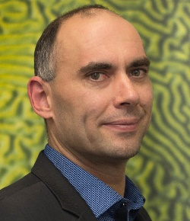

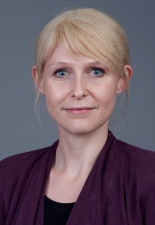



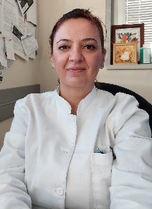

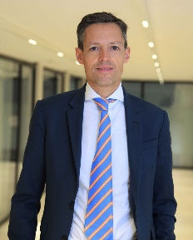
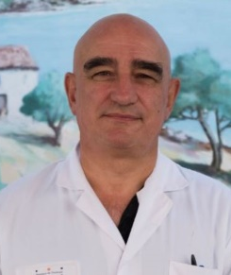




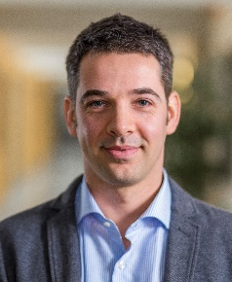

Module Working Group Members
Verheyden Geert
Belgium
Alt Murphy Margit Sweden
Branscheidt Meret
Switzerland
Cabanas-Valdés Rosa Spain
Essers Bea
Belgium
Kwakkel Gert
Netherlands
Lakičević Sandra
Bosnia & Herzegovina
Lampropoulou Sofia
Greece
Luft Andreas
Switzerland
Marque Philippe
France
Moore Sarah
UK
Munoz-Novoa Maria
Sweden
Solomon John
India
Stinear Cathy
New Zealand
Swinnen Eva
Belgium
Turolla Andrea
Italy

Slide 4
ESO Stroke Action Plan for Europe
30 targets and 72 research priorities within 7 domains
One domain targets stroke rehabilitation improving management, outcome and quality of life
Rehabilitation defined as «a set of measures that assist individuals, who experience or are likely to experience disability, to achieve and maintain optimal functioning in interaction with their environment»
Specific principles of motor rehabilitation not addressed
Norrving et al. Eur Stroke J 2018; WHO 2011

Slide 5
Aim
To deliver an agreed definition of motor rehabilitation after stroke
Supported by a framework synthesizing key literature to provide a state-of-the-art overview of the stroke motor rehabilitation domain
To guide educators, to update clinicians and to enable researchers to identify gaps in the evidence base

Slide 6
Development of the definition
Panel of experts (MWG) convened by ESO Guideline Board (n=14)
Three-round process
Online discussion, first draft and online survey (April-June 2022)
Online discussion, revision and second round survey (July-Aug 2022), requiring 75% agreement
Online presentation of results, further discussion and fine-tuning (Sep 2022)
Also,
MWG members presented the agreed definition to a convenience sample of clinicians (8 MDs, 33 PTs and 9 OTs)
Feedback collated and discussed with final fine-tuning in December 2022

Slide 7
ESO consensus-based definition of Motor Rehabilitation after Stroke
“Motor rehabilitation is a process that engages people with stroke in order to benefit their motor function, activity capacity and performance in daily life. It is necessary for all people with residual motor disability whose goal is to enhance their functioning, independence and participation.
Motor rehabilitation strives to reduce motor impairments and improve functioning in activities through learning- and use-dependent mechanisms. The trajectory of motor and functional recovery varies between patients and stages of recovery. At early stages, behavioral restitution of motor function depends on the underlying mechanisms of spontaneous neurological recovery. At later stages, further functional improvements can be achieved by compensations.
Motor rehabilitation is guided by regular assessment of motor function and activity using consensus-based measures, including patient-reported outcomes. Results are discussed with the patient and their carers in order to set personal goals.
The core element of motor rehabilitation incorporates principles of motor control in which patients learn to optimize and adapt their motor, sensory and cognitive functioning through appropriately dosed, repetitive, goal-oriented, progressive, task- and context-specific training.
Motor rehabilitation supports people with stroke to maximise health, well-being and quality of life.”

Slide 8
Framework
Presenting the ICF as the central concept and contextualising it to motor rehabilitation
Summary of the biology of recovery, distinguishing between early versus later recovery
Widely recommended motor assessments and prediction tools
Summary of strongly recommended evidence-based interventions from recent motor rehabilitation guidelines

Slide 9
Discussion
Strengths
Expertise of the MWG
Three-round process
Consultation with clinical stakeholders
Considerations
Provision of motor rehabilitation differs across the world, but fundamentals of definition are likely similar
Definition paragraph consisting of several elements, but motor rehabilitation is multi-faceted
A definition that is straightforward for everyone may not cover the specificities sought after by professionals

Slide 10
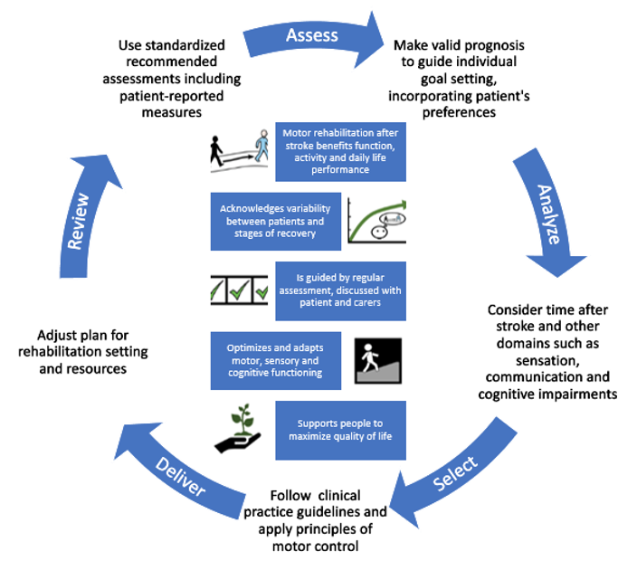
Conclusion
First ESO consensus-based definition of motor rehabilitation after stroke
Basis for producing ESO motor rehabilitation guidelines

