Slide 1
ESO Guideline on Small Vessel Disease, Part 2:
Lacunar Ischaemic Stroke
Module Working Group: Wardlaw, Lindgren, Jokinen, Debette, Staals, Doubal, Pantoni, Chabriat, De Leeuw, Dichgans, Pavlovic, Schmidt
Fellows: Katsanos, Ornello, Pasi, Rudilosso Taylor-Rowan
ESO Guideline Support: Quinn, Hussain, Brüchert,
30 October 2023, Guideline Webinar

Slide 2
Disclosures
Intellectual Disclosures:
Academic grants from national and international funders for research into epidemiology, clinical and cognitive impacts, mechanisms and treatment of small vessel disease.
Editorial roles
Clinical trials roles
Financial Disclosures:
None

Slide 3
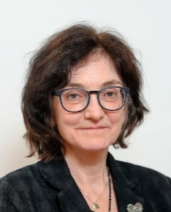



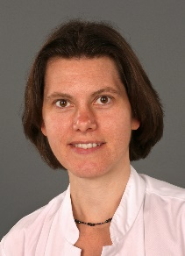
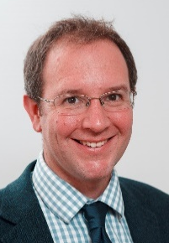
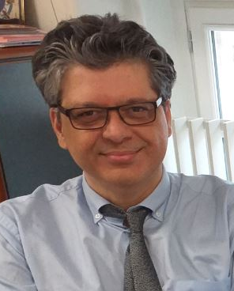
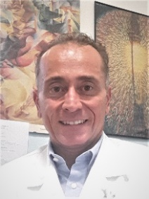


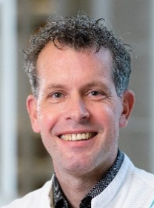
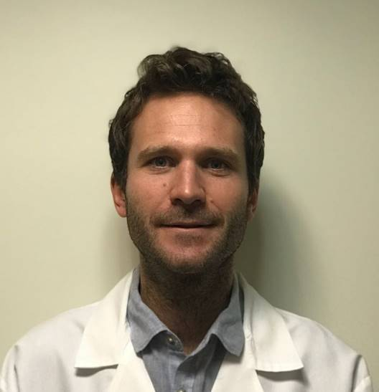
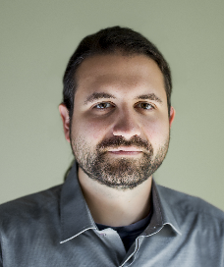
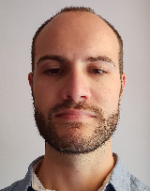
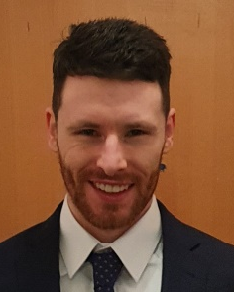
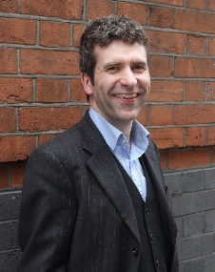


Module Working Group Members, Fellows, Support
Co-Chairs
PICO leads
Joanna Wardlaw
UK
Arne Lindgren
Sweden
Hanna Jokinen
Finland
Stephanie Debette
France
Julie Staals
Netherlands
Fergus Doubal
UK
Guideline
Members
Hugues Chabriat
France
Aleksandra Pavlovic
Serbia
Leonardo Pantoni
Italy
Reinhold Schmidt
Austria
Martin Dichgans
Germany
Frank-Erik De Leeuw
Netherlands
Guideline Fellows
Guideline support
Salvatore Rudilosso
Spain
Marco Pasi
France
Aristeidis Katsanos
Canada
Raffaele Ornello
Italy
Martin Taylor-Rowan
UK
Terry Quinn
UK
Salman Hussain
Czech Republic
Yvonne Brüchert Switzerland

Slide 4
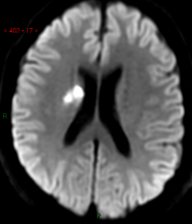
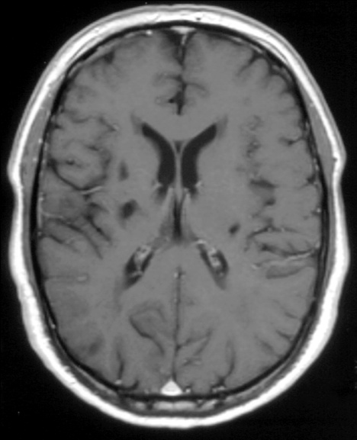
Lacunar ischaemic stroke
An important type of small vessel disease
A quarter of ischaemic strokes, often ‘mild’
Usually due to intrinsic cerebral small vessel disease,
Sometimes due to atherothrombosis or embolism – difficult to tell in the clinic
Difficult to differentiate from other stroke subtypes clinically in the first few hours
Dependency and early recurrent stroke are less frequent than in other stroke subtypes;
Cognitive impairment in >50% but often not collected/reported in trials
Acute
Chronic
ESO Guideline on Covert cSVD published ESJ May 2021

Slide 5
Guideline overview – lacunar ischaemic stroke
Patients: with suspected lacunar ischaemic stroke
not included: covert cSVD, haemorrhage, cognitive, other stroke+cSVD presentations
Interventions:
Acute
1. Thrombolysis
2. Antiplatelets
3. Antihypertensive
4. Progressing
5. Other interventions
Secondary Prevention
6. Antiplatelets
7. Antihypertensive
8. Lipid lowering
9. Lifestyle interventions
10. Other interventions
Comparator:
Avoidance of, or less intensive intervention
Outcomes:
1. Stroke (ischaemic or haemorrhagic)
2. Dependency
3. Death
4. Cognitive decline or dementia
5. Major adverse cardiovascular events
6. Mobility or gait disorder
7. Mood disorders including depression

Slide 6
Issues – lacunar ischaemic stroke
Total literature assessed = >4689 hits, Average >662/ PICO
vanishingly few trials in lacunar stroke
very few trials provided data on stroke subtypes
few trials subtyped stroke
most lacunar stroke is mixed amongst other stroke subtypes
Heterogenous terminology and definitions – searching and extraction difficult
We performed numerous new meta-analyses and network meta-analyses
Close cross-reference to other relevant ESO Guidelines to avoid inconsistencies

Slide 7
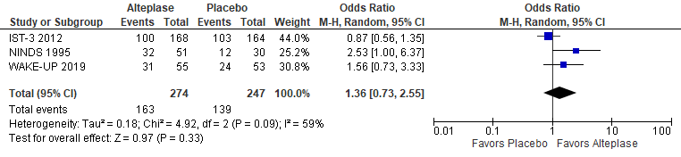
PICO 1, Acute, thrombolysis treatment
Does thrombolytic treatment (including at extended time window and wake-up stroke, alteplase/tenecteplase/other), compared to avoiding this intervention/other thrombolytic/dose/etc, reduce recurrent ischaemic stroke, dependency, death, cognitive impairment or dementia, haemorrhagic stroke, MACE, mobility or gait disorder, and mood disorders?
897 abstracts, 47 full text review, 6 studies for data extraction from 5 RCTs
Subgroups of: NINDS, IST-3, Wake-UP, [ENCHANTED, PRISMS]
524 patients alteplase vs control
Good functional outcome, 3 trials, OR 1.36 [0.73, 2.55]
sICH, death, 1 trial

Slide 8
PICO 1, acute, thrombolysis treatment
Does thrombolytic treatment (including at extended time window and wake-up stroke, alteplase/tenecteplase/other), compared to avoiding this intervention/other thrombolytic/dose/etc, reduce recurrent ischaemic stroke, dependency, death, cognitive impairment or dementia, haemorrhagic stroke, MACE, mobility or gait disorder, and mood disorders?
Evidence-based Recommendation
We suggest that patients with suspected acute lacunar ischaemic stroke should be assessed for and receive treatment with 0.9 mg/kg alteplase according to current guidelines for the treatment of acute ischaemic stroke, since the limited data available suggest that the outcomes for patients with lacunar ischaemic stroke are consistent with the overall results of alteplase trials.
Quality of evidence: Very Low ⊕
Strength of recommendation: Weak for intervention ↑?
Data are very limited;
Lacunar stroke is difficult to diagnose acutely;
Power is limited.

Slide 9
PICO 1, acute, thrombolysis treatment
Expert Consensus Statement
1. Twelve of 12 MWG members agreed that in patients with suspected acute lacunar ischaemic stroke, with no contraindication to thrombolytic treatment according to current clinical guidelines for thrombolytic treatment (including wake up stroke), there is no evidence for withholding thrombolytic treatment. Therefore these patients should receive intravenous alteplase at standard dose (0.9mg/kg) as quickly as possible according to current clinical guidelines.
2. Twelve of 12 MWG members agreed that in patients with suspected acute lacunar ischaemic stroke there are insufficient data to support use of thrombolytic drugs other than alteplase, or a lower dose of alteplase (unless there is another reason) at the present time.
Consistent with Berge et al, ESO GL on thrombolysis, ESJ 2021

Slide 10
PICO 2 & 6, antiplatelet treatment, acute and secondary prevention
Does antiplatelet treatment, acutely or long-term (considering single/dual, duration, and whether any particular antiplatelet or combination of antiplatelets is better), compared to avoiding/less of/alternative antiplatelet intervention, reduce recurrent ischaemic stroke, dependency, death, cognitive impairment or dementia, haemorrhagic stroke, MACE, mobility or gait disorder, and mood disorders?
737 abstracts, 110 full text review, 29 for data extraction from 25 RCTs → 3 PICO 2, 22 PICO 6
PICO2= Acute: CAST, IST, aspirin v placebo (N=10,879); TARDIS, 3 APT vs standard, N=1,288;
Meta-analysis not possible: different outcomes
CHANCE-2, N=1750, recurrent stroke ticagrelor+asp 3.6% vs clopidogrel+asp 7.0%
PICO6= Secondary: aspirin, clopidogrel, dipyridamole, ticlopidine, ticagrelor, cilostazol, prasugrel, terutroban, triflusal, voraxapar
Different combinations, comparators, outcomes, large heterogeneity,
9 meta-analyses
3 network meta-analyses - exploratory

Slide 11
PICO 2, antiplatelet treatment, acute
Does acute treatment with antiplatelets (considering single/dual, duration, and whether any particular antiplatelet or combination of antiplatelets is better), compared to avoiding/less of/alternative antiplatelet intervention, reduce recurrent ischaemic stroke, dependency, death, cognitive impairment or dementia, haemorrhagic stroke, MACE, mobility or gait disorder, and mood disorders?
Evidence-based Recommendation
In patients with suspected acute lacunar ischaemic stroke, there is continued uncertainty about a specific combination of antiplatelet therapy over monotherapy.
Quality of evidence Very low ⊕
Strength of recommendation: -
Expert Consensus Statement
Twelve of 12 MWG members agree with the statement that in patients with suspected lacunar ischaemic stroke, initiation of antiplatelet therapy should be started as soon as possible after stroke onset.
Comment: It may be reasonable to use dual antiplatelet therapy short term according to
the CHANCE and POINT trials’ protocols. Comparable with Dawson et al, ESO expedited GL 2021.

Slide 12
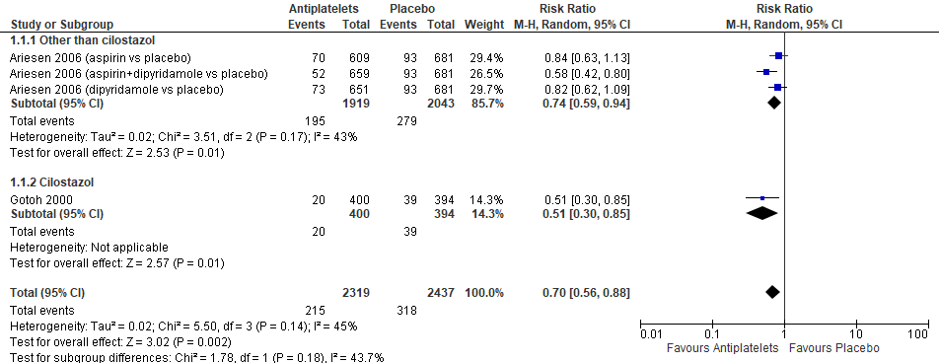
PICO 6, antiplatelet treatment, secondary prevention
Recurrent stroke: Meta-analysis:
Clopidogrel, ticagrelor, ticlopidine, etc, not superior to aspirin alone
SPS3 and MATCH showed no benefit but increased risk of clopidogrel+aspirin versus aspirin or clopidogrel alone

Slide 13
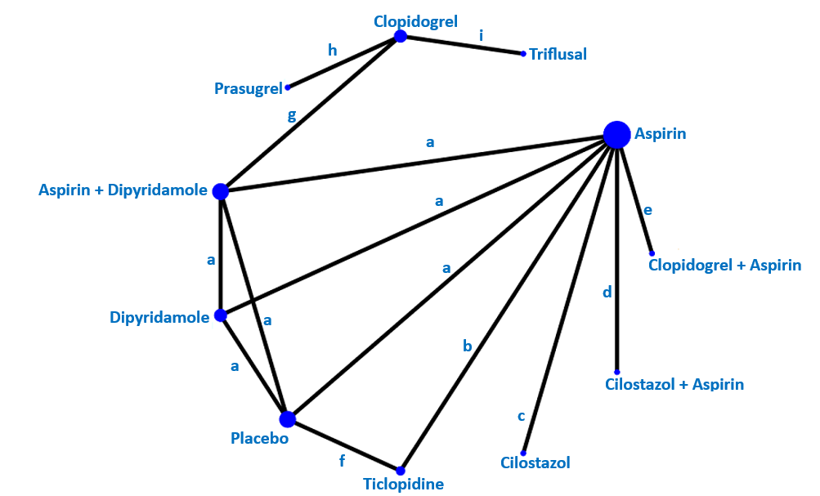
PICO 6, antiplatelet treatment, secondary prevention
Exploratory Network Meta-analysis “Any recurrent stroke”
N=21080
RR (95%CI)
Aspirin+Dipyridamole vs Placebo 0.56 (0.41, 0.77)
Cilostazol vs Placebo 0.55 (0.36, 0.84)
Clopidogrel vs Placebo 0.59 (0.42, 0.83)
To reduce any recurrent stroke
Exploratory, often indirect, all low certainty evidence

Slide 14
PICO 6, antiplatelet treatment, secondary prevention
Does long-term treatment with antiplatelets (single/dual, duration, and whether any particular antiplatelet or combination of antiplatelets is better), compared to avoiding/less of/alternative antiplatelet intervention, reduce recurrent ischaemic stroke, dependency, death, cognitive impairment or dementia, haemorrhagic stroke, MACE, mobility or gait disorder, and mood disorders?
Evidence-based Recommendation
In patients with suspected lacunar ischaemic stroke, for secondary prevention of long-term adverse outcomes, we recommend long term single antiplatelet therapy with aspirin or clopidogrel from 2-4 weeks after stroke onset.
Quality of evidence: Moderate ⊕⊕⊕
Strength of recommendation: Weak for intervention ↑?
Expert Consensus Statement
1. In patients with suspected lacunar ischaemic stroke, 12 of 12 MWG members recommend against the use of long-term* dual or triple antiplatelet therapy. Instead, single antiplatelet therapy should be used as per the Evidence Based Recommendation above, unless other conditions warrant a combination of these medications.
2. In patients with suspected lacunar ischaemic stroke, 11 of 12 MWG members agreed that the current evidence was inadequate to recommend routine use of cilostazol to prevent adverse long term outcomes.
* Defined as more than 2-4 weeks
Consistent with Dawson et al ESO Guideline on secondary stroke prevention, ESJ 2022

Slide 15
PICO 3 & 7, antihypertensive treatment, acute and secondary prevention
Does antihypertensive treatment, given acutely or long term (considering agent and BP target), compared to avoiding this intervention, reduce recurrent ischaemic stroke, dependency, death, cognitive impairment or dementia, haemorrhagic stroke, MACE, mobility or gait disorder, and mood disorders?
961 abstracts, 99 full text review, 11 data extraction from 7 RCTs: PICO 3, 5 RCTs; PICO 7, 2 RCTS
PICO3= Acute: CATIS, SCAST, ENOS, VENTURE, ENCHANTED; N=3567 patients
Data on dependency, 5 trials; ICH 1 trial; MACE, 2 trials; depression, 1 trial.
PICO7= Secondary: SPS3, N=3020, SBP target 130–149 vs < 130 mm Hg
PRESERVE, n=111, SBP target 130–140 vs <125 mmHg
Data on recurrent stroke, MACE, ICH, cognition
Notes:
For VENTURE patients with SBP > 185 and < 150 were excluded; for ENCHANTED: SBP < =185 mm Hg before IV tPA

Slide 16
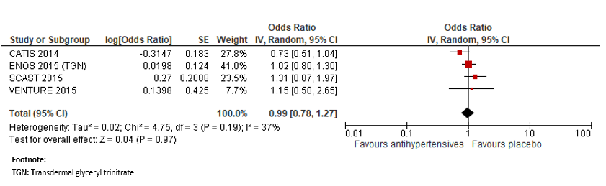
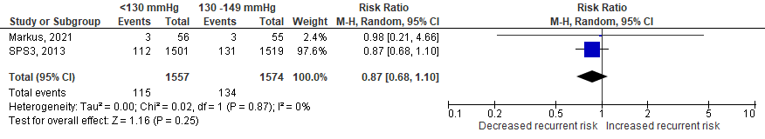
Meta-analysis, antihypertensive treatment, acute and secondary prevention
PICO 3 – Acute BP lowering, functional outcome (mRS 0-2):
No difference with thrombolysis
OR 0.99 (0.50-1.27) P=0.97
MACE, 2 trials, HR: 1.75 (0.68-4.52). ICH, depression, 1 trial each, neutral
PICO 7 – Secondary prevention, BP lowering to target, recurrent stroke:
RR 0.87 (0.68–1.10) P=0.25
MACE, cognitive function, neutral. ICH reduced

Slide 17
PICO 3, antihypertensive treatment, acute
Does immediate antihypertensive treatment (considering agent and BP target), compared to avoiding this intervention, reduce recurrent ischaemic stroke, dependency, death, cognitive impairment or dementia, haemorrhagic stroke, MACE, mobility or gait disorder, and mood disorders?
Evidence-based Recommendation
1. In hospitalized patients with suspected acute lacunar ischaemic stroke and BP <220/110 mmHg, not treated with intravenous thrombolysis, we suggest against the routine use of blood pressure lowering agents in the hyperacute phase, unless this is necessary for a specific comorbid condition.
Quality of evidence: Low ⊕⊕
Strength of recommendation: Weak against intervention ↓?
2. In patients with suspected acute lacunar ischaemic stroke undergoing intravenous thrombolysis we suggest following the same guideline as in acute ischaemic stroke at large, i.e. maintaining BP below 185/110 mmHg before bolus and below 180/105mmHg after bolus, and for 24 hours after alteplase infusion.
Quality of evidence: Very Low ⊕⊕
Strength of recommendation: Weak for intervention ↑?
3. In patients with suspected acute lacunar ischaemic stroke there is continued uncertainty over the benefits and risks of temporarily stopping versus continuing previous blood pressure lowering therapy.
Quality of evidence: Very Low ⊕⊕
Strength of recommendation: -

Slide 18
PICO 3, antihypertensive treatment, acute
Expert Consensus Statement
1. 12 of 12 MWG members agreed that there is insufficient evidence at present to provide a precise timeframe during which BP lowering agents should be avoided in patients with suspected acute lacunar ischaemic stroke. Based on current limited evidence, blood pressure lowering therapy should be avoided for at least 24 hours after symptom onset.
2. When antihypertensive drugs need to be used in patients with suspected acute lacunar ischaemic stroke undergoing intravenous thrombolysis and with BP > 180/105mmHg, 12 of 12 MWG members agreed that there is no advantage/disadvantage of one antihypertensive medication over another, hence any antihypertensive drug may be used, as long as blood pressure is closely monitored.
3. 11 of 12 MWG members agreed that in patients with suspected acute lacunar ischaemic stroke not treated with intravenous thrombolysis and blood pressure >220/120 mmHg, careful blood pressure reduction (<15% systolic blood reduction in 24 hours) is reasonable and likely to be sage. No specific blood pressure lowering agent can be recommended.
Consistent with Sandset et al ESO Guideline on acute BP management, ESJ 2021

Slide 19
PICO 7, antihypertensive treatment, secondary prevention
Evidence-based Recommendation
In patients with suspected/presumed lacunar ischaemic stroke we recommend the use of antihypertensive treatment to prevent recurrent stroke and MACE.
Quality of evidence: Moderate ⊕⊕⊕
Strength of recommendation: Strong for intervention ↑↑
Expert Consensus Statement
In patients with suspected/presumed lacunar ischaemic stroke for secondary prevention:
1. All group members suggest that: BP should be appropriately monitored and well controlled, when possible through use of out of office blood pressure measurements. We cannot advise any specific antihypertensive treatment.
2. All but one group members agree that aiming for BP <130/80 mmHg as generally recommended for patients with previous ischaemic stroke or TIA may be reasonable, but that drastic BP reductions and important BP variability should be avoided, probably targeting SBP between 125 and 130 mmHg and DBP between 70 and 80 mmHg.
Consistent with Dawson et al ESO Guideline on secondary stroke prevention, ESJ 2022

Slide 20
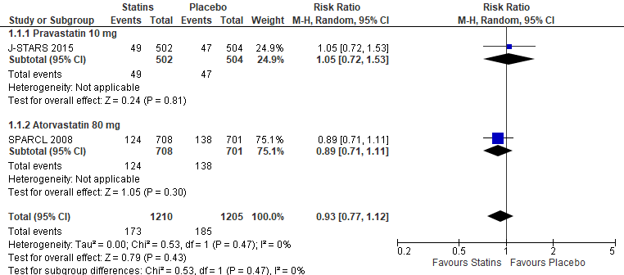
PICO 8, lipid lowering, secondary prevention
Does lipid lowering (considering a particular agent, dose, target), compared to less intense or avoiding this intervention, reduce recurrent ischaemic stroke, dependency, death, cognitive impairment or dementia, haemorrhagic stroke, MACE, mobility or gait disorder, and mood disorders?
575 abstracts; 23 papers full text; 2 RCTs included, N=2415.
SPARCL – atorvastatin 80 mg daily vs placebo; 4.9 yrs; 1407/4731 had ‘small vessel’ stroke
Primary outcome – any stroke
J-STARS – pravastatin 10mg daily vs placebo; 4.9 yrs; 1006/1578 had lacunar stroke
Primary outcome –stroke/TIA, 49 vs 47,
RR 0.93 [0.77, 1.12] p=0.43

Slide 21
PICO 8, lipid lowering, secondary prevention
Does lipid lowering (considering a particular agent, dose, target), compared to less intense or avoiding this intervention, reduce recurrent ischaemic stroke, dependency, death, cognitive impairment or dementia, haemorrhagic stroke, MACE, mobility or gait disorder, and mood disorders?
Evidence-based Recommendation
There is continued uncertainty regarding the effect of lipid lowering specific to lacunar stroke. However we recognise that lipid lowering is effective in reducing clinically adverse outcomes in patients with undifferentiated ischaemic stroke.
Quality of evidence: - Low ⊕⊕
Strength of recommendation: -
Expert consensus statement
Twelve of 12 MWG members agreed that patients with lacunar ischaemic stroke should receive lipid lowering therapy given there is some evidence of benefit and no clear evidence of harm.
Consistent with Dawson et al, ESO Guideline on secondary stroke prevention, ESJ 2022

Slide 22
PICO 9, lifestyle intervention, secondary prevention
Does treatment with lifestyle interventions [e.g. smoking cessation, dietary interventions, weight reduction, physical exercise, cognitive/behavioural or social interventions, sleep/CPAP, or a mixture of these], compared to less intense or avoiding this intervention, reduce recurrent ischaemic stroke, dependency, death, cognitive impairment or dementia, haemorrhagic stroke, MACE, mobility or gait disorder, and mood disorders?
632 abstracts; 24 papers full text; 3 papers (2 RCTs) included.
2 RCTs addressing the effect of lifestyle interventions in patients with lacunar ischaemic stroke:
One - physical exercise: HITPALS, n=63, recent lacunar ischaemic stroke
3-month home-based high-intensity interval training (15 minutes a day, 5 days per week vs usual care.
Primary outcome - cardiorespiratory fitness (Graded Cycling Test with Talk Test)
No difference in other outcomes
One - dietary (B vitamins): VITATOPS, n=230, recent lacunar ischaemic stroke, MCI,
Daily B vitamins or placebo
Primary outcome – cognitive change at 5 years - no effect

Slide 23
PICO 9, lifestyle intervention, secondary prevention
Does treatment with lifestyle interventions [e.g. smoking cessation, dietary interventions, weight reduction, physical exercise, cognitive/behavioural or social interventions, sleep/CPAP, or a mixture of these], compared to less intense or avoiding this intervention, reduce recurrent ischaemic stroke, dependency, death, cognitive impairment or dementia, haemorrhagic stroke, MACE, mobility or gait disorder, and mood disorders?
Expert consensus statement
Despite lack of direct evidence, 12 of 12 MWG members suggest that it is advisable to promote healthy lifestyle modifications in patients with lacunar stroke as recommended in secondary prevention for stroke and VCI. These include regular physical exercise, maintaining healthy body weight, avoiding smoking and excess alcohol, and eating a healthy balanced diet with low sodium intake.

Slide 24
PICO 5 & 10: Other treatment, acute and secondary prevention
Does acute treatment with other agents, compared to less intense or avoiding this intervention, reduce recurrent stroke, recurrent ischaemic stroke, dependency, death, cognitive impairment or dementia, haemorrhagic stroke, MACE, mobility or gait disorder, and mood disorders?
e.g. Phosphodiesterase inhibitors-3 inhibitors [e.g. cilostazol, pentoxifylline], anti-inflammatory agents [e.g. minocycline], anticoagulants, Nitric Oxide donors [e.g. transdermal glyceryl trinitrate], Phosphodiesterase inhibitors-5 [sildenafil, tadalafil, dipyridamole], or other relevant agents [e.g. heparin] not in other PICOs
PICO5= Acute: avoid GTN, heparin/LMW heparinoid, Xueshuantong; uncertainty for Magnesium, cilostazol, other agents
PICO10= Secondary prevention: cannot recommend any agents e.g. phosphodiesterase inhibitors-3 inhibitors, anti-inflammatory agents, anticoagulants, nitric oxide donors, phosphodiesterase inhibitors-5, etc; avoid anticoagulation unless the patient has AF.
PICO 4, acute lacunar ischaemic stroke and progressive symptoms
Do antiplatelets/anticoagulants/thrombolysis/other agent, compared to avoiding this intervention, reduce recurrent ischaemic stroke, dependency, death, cognitive impairment or dementia, haemorrhagic stroke, MACE, mobility or gait disorder, and mood disorders?
Answer to PICO4 question: No.

Slide 25
Conclusion: patients with suspected/presumed lacunar ischaemic stroke
Treat with alteplase according to thrombolysis guidelines
Start antiplatelet treatment ASAP
Use single antiplatelet long term
No evidence to support BP reduction acutely
Manage BP in secondary prevention but no evidence for low targets or specific drug
Lipid lowering limited data – no evidence of harm
Lifestyle modifications – should be encouraged
Other treatments – avoid GTN, heparin acutely; no evidence for others
Patients with lacunar stroke and AF should receive anticoagulation, and strict risk factor control
Progressive lacunar stroke, no evidence; trials needed

Slide 26
Limitations
Subgroup analyses; noisy subtyping; limited power; incomplete range of outcomes → lack of conventionally reliable data on acute treatment or secondary prevention
All trials in ischaemic stroke should:
subtype stroke
report outcomes by stroke subtype, clearly defined.
Trials in lacunar stroke should:
be sufficiently powered to answer the research questions
always report basic clinical outcomes - safety, cognitive impairment, dependency, recurrent stroke, also when not being primary outcomes
use standardised assessment tools throughout
Future research

Slide 27
Module Working Group Members, Fellows, Support
Co-Chairs
PICO leads
Thank you
Joanna Wardlaw
UK
Arne Lindgren
Sweden
Hanna Jokinen
Finland
Stephanie Debette
France
Julie Staals
Netherlands
Fergus Doubal
UK
Guideline
Members
Hugues Chabriat
France
Aleksandra Pavlovic
Serbia
Leonardo Pantoni
Italy
Reinhold Schmidt
Austria
Martin Dichgans
Germany
Frank-Erik De Leeuw
Netherlands
Guideline Fellows
Guideline support
Salvatore Rudilosso
Spain
Marco Pasi
France
Aristeidis Katsanos
Canada
Raffaele Ornello
Italy
Martin Taylor-Rowan
UK
Terry Quinn
UK
Salman Hussain
Czech Republic
Yvonne Brüchert Switzerland

