Slide 1
European Stroke Organisation guideline on screening for subclinical AF after stroke or TIA of undetermined origin
Marta Rubiera, Ana Aires, Kateryna Antonenko, Sabrina Lémeret, Christian H. Nolte, Jukka Putaala, Renate B. Schnabel, Anil M Tuladhar, David J. Werring, Dena Zeraatkar, Maurizio Paciaroni
8th European Stroke Conference (ESOC)
2022/05/06 - Lyon, France

Slide 2
Disclosures
Marta Rubiera: Intellectual disclosures: Chair of the Brain and Heart ESO Committee. Financial disclosures: Speaker Honorarium Pfizer
Ana Aires: none
Kateryna Antonenko: none
Christian Nolte received research grants from German Ministry of Research and Education, German Center for Neurodegenerative Diseases, German Center for cardiovascular Research, and speaker and/or consultation fees from Bayer, Boehringer Ingelheim, Bristol-Myers Squibb, Pfizer, Abbott, Alexion and W.L. Gore and Associates.
Jukka Putaala has received honoraria for speaking from Boehringer-Ingelheim, Bayer, BMS-Pfizer, and Abbott, and for advisory boards from Boehringer-Ingelheim, Bayer, BMS-Pfizer, Portola, and Herantis Pharma. He is a Visiting Editor of Terve Media and is a shareholder of Vital Signum. He has received grants from Academy of Finland, Hospital District of Helsinki and Uusimaa, and Finnish Foundation for Cardiovascular Research. He serves in the Board of Directors of ESO and as the Board Chair of the Nordic Stroke Society.
Renate Schnabel has received funding from the European Research Council (ERC) under the European Union’s Horizon 2020 research and innovation programme under the grant agreement No 648131, from the European Union’s Horizon 2020 research and innovation programme under the grant agreement No 847770 (AFFECT-EU) and German Center for Cardiovascular Research (DZHK e.V.) (81Z1710103); German Ministry of Research and Education (BMBF 01ZX1408A) and ERACoSysMed3 (031L0239). She has received lecture fees and advisory board fees from BMS/Pfizer outside this work.
Anil Tuladhar is a junior staff member of the Dutch Heart Foundation (grant number 2016T044).
David Werring has received honoraria for speaking from Bayer, Portola and Alexion, and for advisory boards from Bayer, NovoNordisk, Alnylam and Portola.
Maurizio Paciaroni received speaker and/or consultation fees from Bayer, Boehringer Ingelheim, Bristol-Myers, Squibb, Pfizer, Daiichi Sankyo, Sanofi

Slide 3
European Stroke Organisation guideline on screening for subclinical AF after stroke or TIA of undetermined origin
Inclusion Criteria
Randomised controlled trials (observational studies in case no RCTs were found)
Prospective and restrospective studies > N=50
Adults (>18 years)
Stroke or TIA of undetermined origin
Study in humans
Since 2000
Comparative studies for meta-analysis
Single arm studies for background information
Exclusion Criteria
Study inclusion criteria or population not clearly defined
Does not report defined outcomes
Other languages than German, Italian, English, Portuguese, Spanish, French, Ukrainian, Finnish, Swedish, Norwegian, Danish
Outcome
Detection of AF (any duration) | 8,7
Detection of long-term duration AF (≥30 seconds) | 7,9
Rate of anticoagulation | 7,6
Recurrent ischaemic stroke | 8,4
Intracranial haemorrhage | 7,0
Major haemorrhage (intracranial or extracranial) | 7,3
Systemic embolism | 7,4
Mortality | 8,2
Functional outcome (e.g modified Rankin score) | 7,1
Device related adverse events | 6,1
Detection of short-term duration AF (<30 seconds) | 6,4
Timing of initiation of anticoagulation from AF detection | 4,7
Patient’s compliance and acceptability with the AF screening method | 5,6
Patient-reported outcome measures of quality of life (e.g. PROMIS-10, EQ 5-D) | 5,8

Slide 4
Evidence-based Recommendations
Longer duration of cardiac rhythm monitoring compared to a shorter duration
PICO 1: In adult patients with ischaemic stroke or TIA of undetermined origin, does a longer duration of cardiac rhythm monitoring compared to a shorter duration of cardiac rhythm monitoring increase the detection of subclinical AF, increase the rate of anticoagulation, reduce the rate of recurrent stroke or systemic embolism, intracranial haemorrhage, any major haemorrhage, mortality and improve functional outcome?

Slide 5
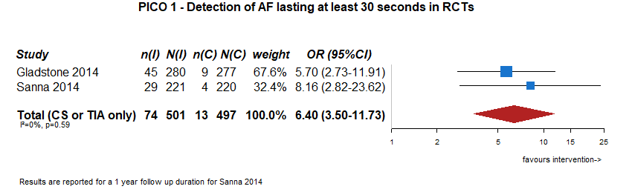
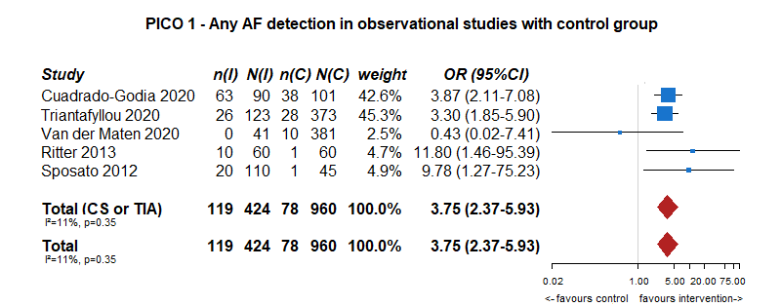
Outcome: detection of subclinical AF

Slide 6
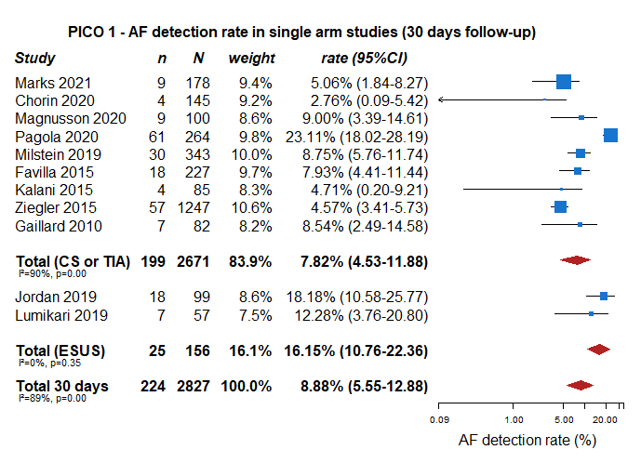
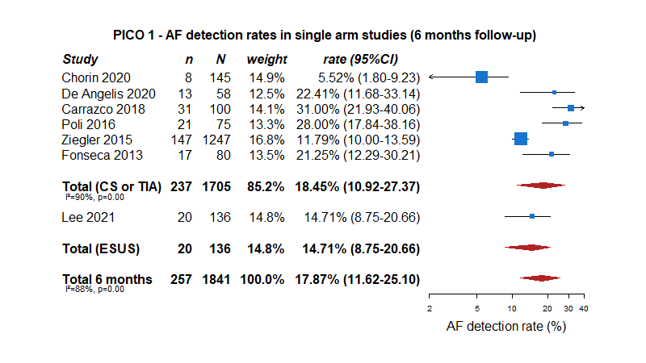
Outcome: detection of subclinical AF

Slide 7
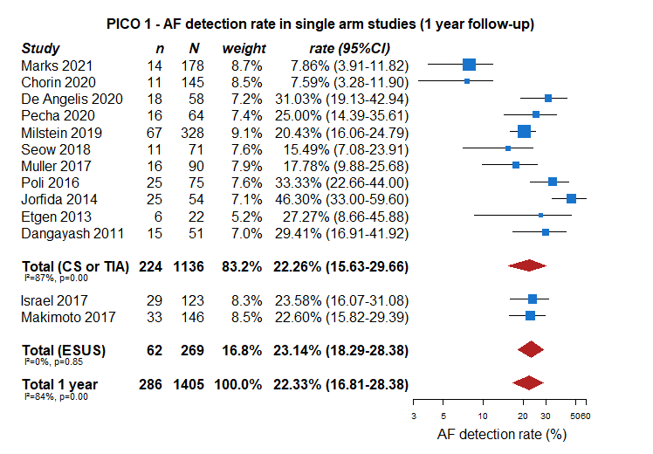
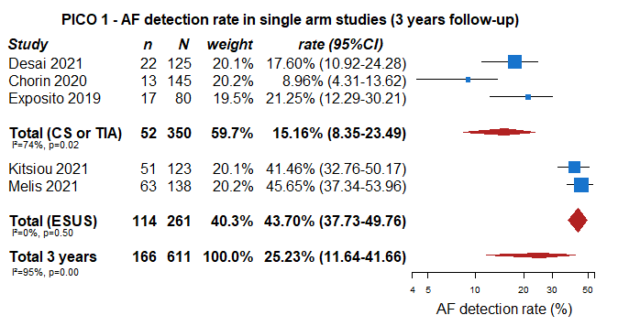
Outcome: detection of subclinical AF

Slide 8
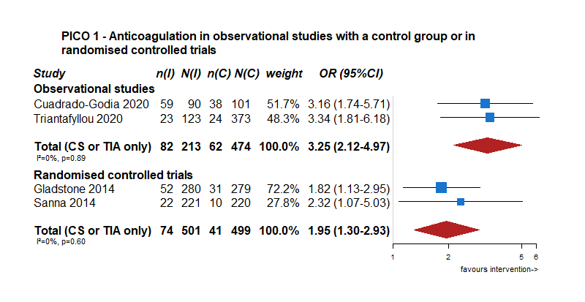
Outcome: rate of anticoagulation

Slide 9
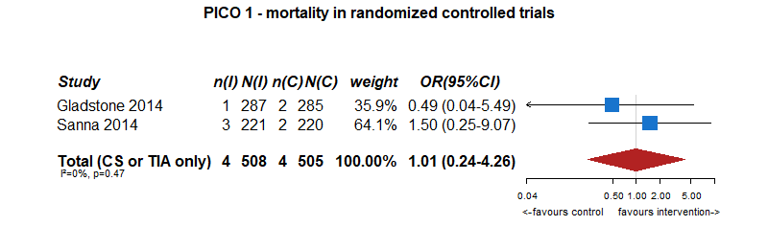
Outcome: rates of recurrent stroke or systemic embolism, mortality, intracranial haemorrhage, and major haemorrhage (intracranial or extracranial)
Recurrent ischemic stroke
2 | randomised trials |  |  |  |  |  | 16/508 (3.1%) | 21/505 (4.2%) | OR 0.74 (0.38 to 1.46) | 10 fewer per 1 000 (from 25 fewer to 18 more)

Slide 10
Evidence-based Recommendations
The addition of out-patient cardiac rhythm monitoring compared to in-hospital
cardiac rhythm monitoring alone
PICO 2: In adult patients with ischaemic stroke or TIA of undetermined origin, does the addition of out-patient cardiac rhythm monitoring, compared with in-hospital cardiac rhythm monitoring alone increase the detection of subclinical AF, increase the rate of anticoagulation, reduce the rate of recurrent stroke or systemic embolism, intracranial haemorrhage, any major haemorrhage, mortality and improve functional outcome?

Slide 11
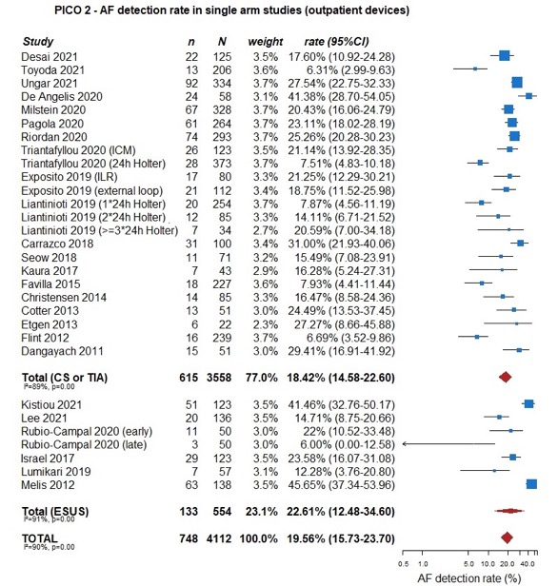
Outcome: detection of subclinical AF

Slide 12
Outcome: detection of subclinical AF

Slide 13
Evidence-based Recommendations
Implantable monitoring devices compared to any non-implantable
external monitoring device
PICO 3: In adult patients with ischaemic stroke or TIA of undetermined origin, do implantable monitoring devices compared to any non-implantable external monitoring device increase the detection of subclinical AF, increase the rate of anticoagulation, reduce the rate of recurrent stroke or systemic embolism, intracranial haemorrhage, any major haemorrhage, mortality and improve functional outcome?

Slide 14
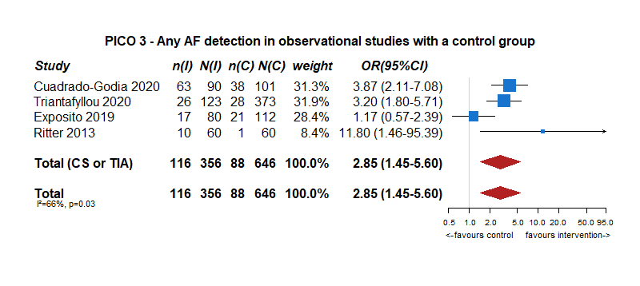
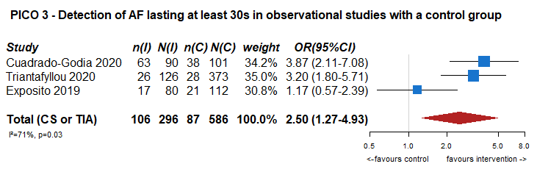
Outcome: detection of subclinical AF
CRYSTAL AF Study (AF duration >30 sec.):
6 months 8.9% intervention group 1.4% control group HR 6.4 (1.9-21.7)
1 year 12.4% 2.0% HR 7.3 (2.6-20.8)

Slide 15
Outcome: detection of subclinical AF

Slide 16
Outcome: rate of anticoagulation
PICO 3 – Anticoagulation in observational studies with a control group

Slide 17
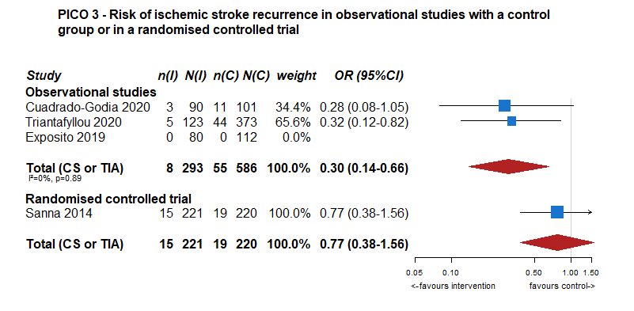
Outcome: rates of recurrent stroke or systemic embolism, mortality, intracranial haemorrhage, and major haemorrhage (intracranial or extracranial)

Slide 18
Evidence-based Recommendations
The presence of potential blood, echocardiographic, ECG or heart and
brain imaging biomarkers, compared to their absence
PICO 4: In adult patients with ischaemic stroke or TIA of undetermined origin, does the presence of potential blood, echocardiographic, ECG or heart and brain imaging biomarkers, compared to their absence, increase the detection of subclinical AF, increase the rate of anticoagulation, reduce the rate of recurrent stroke or systemic embolism, intracranial haemorrhage, any major haemorrhage, mortality and improve functional outcome?

Slide 19
Outcome: detection of subclinical AF
Blood biomarkers
- pro B-type natriuretic peptide (BNP)
Echocardiographic biomarkers
- Left atrial dilation
- Left ventricular abnormalities
ECG biomarkers
- Supraventricular runs
Brain Imaging biomarkers
- Presence of multiple infartcs
- Presence of cortical infarcts

Slide 20
Outcome: detection of subclinical AF
Blood biomarkers
- pro B-type natriuretic peptide (BNP)

Slide 21
Outcome: detection of subclinical AF
Echocardiographic biomarkers
- Left atrial dilation

Slide 22
Outcome: detection of subclinical AF
Echocardiographic biomarkers
- Left ventricular abnormalities

Slide 23
Outcome: detection of subclinical AF
ECG biomarkers
- Supraventricular runs

Slide 24
Outcome: detection of subclinical AF
Brain Imaging biomarkers
- Presence of multiple infartcs
- Presence of cortical/cerebellar infarcts
PICO 4 – Association between cortical/cerebellar infarctions and atrial fibrillation
detection in observational studies

Slide 25
Outcome: detection of subclinical AF

Slide 26
Evidence-based Recommendations
Implantable monitoring devices, compared to any non-implantable
external monitoring device in patients with patent foramen ovale (PFO)
PICO 5: In adult patients with ischaemic stroke or TIA of undetermined origin and patent foramen ovale (PFO), do implantable monitoring devices compared to any non-implantable external monitoring device increase the detection of subclinical AF, increase the rate of anticoagulation, reduce the rate of recurrent stroke or systemic embolism, intracranial haemorrhage, any major haemorrhage, mortality and improve functional outcome?

Slide 27
Outcome: detection of subclinical AF

Slide 28
Outcome: detection of subclinical AF

Slide 29
Outcome: detection of subclinical AF

Slide 30
Areas of future research
Whether subclinical AF is implicated in previous stroke
To investigate for an optimal monitoring duration for subclinical AF
To investigate for an optimal selection for intensive cardiac rhythm monitoring
To investigate for a minimal duration of AF that should be considered causal and lead to anticoagulation
To investigate whether the different monitoring strategies or biomarkers can influence key clinical outcomes:
- recurrent ischaemic stroke or systemic embolism
- intracranial haemorrhage or any major haemorrhage
- mortality
- improved functional outcome.

Slide 31
Conclusions
Take Home Messages:
To maximise AF detection, clinicians should perform the longest possible cardiac rhythm monitoring, starting as soon as possible, in patients with stroke or TIA of undetermined origin.
However, RCTs are needed to determine if increased AF detection improves clinical outcomes.

Slide 32

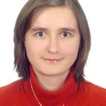






Module Working Group Members
Marta Rubiera
Spain
Ana Aires
Portugal
Kateryna Antonenko
Ukraine
Sabrina Lémeret
Switzerland
Christian H Nolte
Germany
Jukka Putaala
Finland
Renate B Schnabel
Germany
Anil M Tuladhar
The Netherlands
David J Werring
United Kingdom
Dena Zeraatkar
USA - Canada
Maurizio Paciaroni
Italy

